Slide 1
HEPATITIS C
Maternal Infant Health Program (MIHP) Community of Practice Webinar
JUNE 20, 2024
Teresa Juridico, MPH
Viral Hepatitis Prevention Coordinator
MDHHS
WongT@Michigan.gov
Nikki Wesorick, MPH
Disease Intervention Specialist
MDHHS
WesorickN@Michigan.gov

Slide 2
DISCLOSURE
The presenters have no relevant financial relationships to disclose with ineligible companies.

Slide 3
AGENDA
Hepatitis C 101 – Teresa Juridico and Nikki Wesorick
We Treat Hep C Initiative – Teresa Juridico
Hepatitis C Linkage to Cure – Nikki Wesorick

Slide 4
HEPATITIS C 101

Slide 5
HEPATITIS C
Liver infection caused by the hepatitis C virus (HCV) and transmitted through contact with blood from an infected person
  Common modes of transmission include:
    Sharing of drug injection or preparation equipment (e.g., needles, syringes, snorting straws, cottons, cookers, etc.)
    Blood transfusions or organ transplants before 1992
    Occupational exposures to HCV-positive blood, e.g., needlesticks, sharps, mucosal exposures
    Children born to persons with HCV infection
HCV is not transmitted through breast milk, food, water, or casual contact (e.g., hugging, kissing, sharing food/drink with someone living with HCV)
People with HCV are often asymptomatic. When symptoms do appear, they often are a sign of advanced liver disease
There is no vaccine for HCV
Notes:
CLICK for bottom 3 points to appear.

Slide 6
ACUTE VS. CHRONIC HCV
HCV infection can range from an acute, mild illness, lasting a few weeks, to a serious, lifelong chronic infection
ACUTE: defined as the 6-month period following acquisition of HCV.
Signs and symptoms of acute HCV include jaundice, dark urine or clay-colored stools, elevated liver enzymes (ALT > 200 IU/L), fatigue, fever, joint pain, nausea, vomiting, diarrhea, abdominal pain, and loss of appetite
  > 70% of acutely infected persons are asymptomatic
  In the acute phase HCV infection can spontaneously clear in about 25% of people. Approximately 75% of individuals will develop chronic HCV
CHRONIC: HCV infection is long-term infection and can result in serious, even life-threatening health problems such as cirrhosis (severe liver scarring/damage) and liver cancer

Slide 7
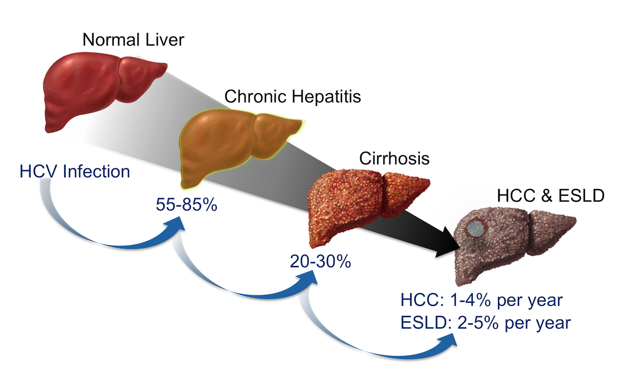
NATURAL HISTORY OF THE DISEASE
HCC = Hepatocellular carcinoma
ESLD = End-stage liver disease
Source: Lingala S, Ghany, MG. Natural History of Hepatitis C. Gastroenterol Clin North Am. 2015; 44: 717-34.

Slide 8
HCV TESTING
It takes two tests to see if you are living with hepatitis C!
ANTIBODY
RNA
An antibody (Ab) test detects if you have been exposed to HCV.
A positive result only means that you have been exposed to HCV.
If Ab test is +, you need an HCV RNA test to know if you are currently infected.
Regardless of clearing the virus or receiving treatment, HCV Ab result will ALWAYS be positive!
An HCV RNA test can tell if you are currently living with HCV.
If you test +, there are medications that can cure you.
Genotype test – identifies the specific strain of virus and is equivalent to an RNA test.

Slide 9
HCV TESTING RECOMMENDATIONS (CDC, 2020)
Universal HCV screening
  HCV screening at least once in a lifetime for all adults aged ≥ 18 years
  HCV screening for all pregnant persons during each pregnancy, regardless of age
One-time HCV testing regardless of age or setting prevalence among persons with recognized conditions or exposures
  Persons living with HIV
  Persons who ever injected drugs and shared needles, syringes, or other drug preparation equipment, including those who injected once or a few times many years ago
  Children delivered by a person with HCV infection
Routine periodic testing for persons with ongoing risk factors, while risk factors persist
  Persons who inject drugs and share needles, syringes, or other drug preparation equipment
  Persons with select medical conditions, including persons who ever received maintenance hemodialysis
Any person who requests HCV testing should receive it, regardless of disclosure of risk (e.g., stigma)
Notes:
CDC’s universal HCV testing recommendations were adopted by the American College of Obstetrician-Gynecologists (ACOG) and endorsed by the Society for Maternal-Fetal Medicine

Slide 10
Hepatitis C – Reportable Condition
By law, hepatitis C is a reportable condition in Michigan!
  This reporting is expressly allowed under HIPAA and required by Michigan Public Act 368 of 1978, Section 333.5111
What is reportable?
  All HCV test results including positive and negative antibody, RNA, and genotype tests
    If applicable, please also report pregnancy status
2024 Reportable Diseases in Michigan List

Slide 11
PRE-PREGNANCY
Ideally, HCV infection would be diagnosed before pregnancy, and, when possible, pre-pregnancy screening for HCV is recommended in individuals who have not yet been tested, in accordance with the recommendation for testing at least once in a lifetime for all adults
Patients testing positive for HCV before pregnancy should be connected to care so they can complete direct-acting antiviral treatment before becoming pregnant

Slide 12
PERINATAL HEPATITIS C
Occurs when a person who is HCV+ passes the virus to the infant in utero or during childbirth (also known as vertical transmission)
Occurs in approximately 5-15% of children delivered by HCV+ persons
  Factors associated with increased risk of perinatal transmission: HIV co-infection, high viral load, prolonged/premature membrane rupture, maternal blood exposure)
No known methods to prevent perinatal HCV transmission during delivery
  No vaccine
  No prophylaxis for HCV
  Method of delivery (such as Cesarean Section has not been shown to decrease perinatal transmission)
Approximately 15-40% of children who receive HCV from perinatal transmission will clear the virus without treatment

Slide 13
PERINATAL HCV TESTING RECOMMENDATIONS (CDC, 2023)
All infants and children born to persons with current or probable HCV infection should be tested for HCV.
  Current HCV infection = has detectable HCV RNA
  Probable HCV infection = HCV antibody-reactive, HCV RNA results are not available
All infants/children born to persons with current or probable HCV infection should be tested for HCV at age 2-6 months with an HCV RNA test
  If not previously been tested, at age 7-17 months with an HCV RNA test
  If not previously been tested, at age ≥18 months with an HCV antibody test with reflex to HCV RNA

Slide 14
PERINATAL HCV TESTING RECOMMENDATIONS (CDC, 2023)
Infants and children with detectable HCV RNA should be managed in coordination with a health care provider with expertise in pediatric hepatitis C for related screenings, preventive services, interventions, and regular follow-up.
Infants/children with detectable HCV RNA should be re-tested with an HCV RNA test at 3 years of age to confirm chronic HCV infection.
Children with detectable HCV RNA can begin treatment as early as 3 years of age.
  Three direct-acting antivirals FDA-approved for use in pediatric populations ages 3+:
    Mavyret® (pangenotypic), Epclusa® (pangenotypic), Harvoni® (treats genotypes 1, 4, 5, or 6)

Slide 15
WHY IS HCV A MAJOR PUBLIC HEALTH THREAT??
THE NUMBERS:
United States
  2.4 million people are estimated to be living with HCV¹
    The actual number may be as high as 4.7 million or as low as 2.5 million¹
  The rate of new HCV infections reported to CDC in 2018 was four times as high as it was in 2010²
Michigan
  In 2022, a total of 3,278 new chronic HCV diagnoses³
  HCV prevalence of 69,100 – which ranks Michigan 7th among all states in the U.S⁴
  Estimates of 200,000+ Michiganders living with HCV
Edlin BR, et al. Hepatology, 62(5), 1353-1363.
U.S. Department of Health and Human Services. Viral Hepatitis in the United States: Data and Trends. Accessed February 2024.
Michigan Department of Health and Human Services. 2022 Hepatitis B and C Surveillance Report. Accessed June 2024.
Rosenberg ES, et al. JAMA Network Open Dec 2018
Michigan Department of Health and Human Services. Michigan’s State Plan on Eliminating Hepatitis C. Accessed February 2024.

Slide 16
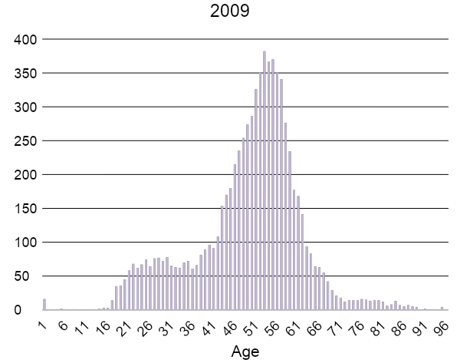
DISTRIBUTION OF NEW HCV DIAGNOSES BY AGE IN MICHIGAN, 2009
Source: Michigan Disease Surveillance System (2009)

Slide 17
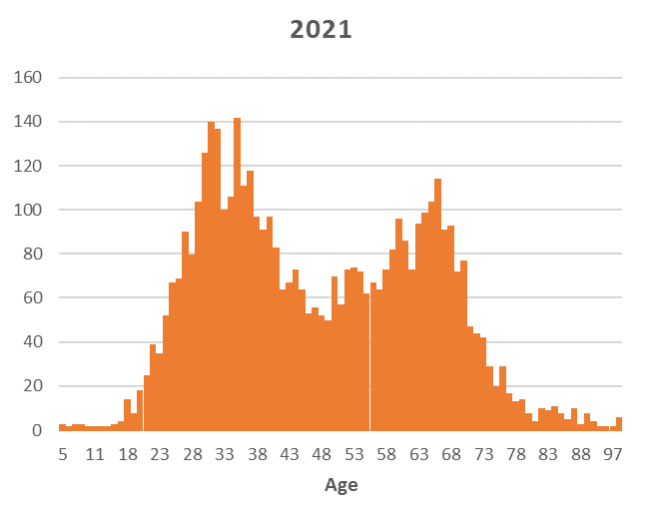

DISTRIBUTION OF NEW HCV DIAGNOSES BY AGE IN MICHIGAN, 2009 V. 2021
Source: Michigan Disease Surveillance System (2009 and 2021)

Slide 18
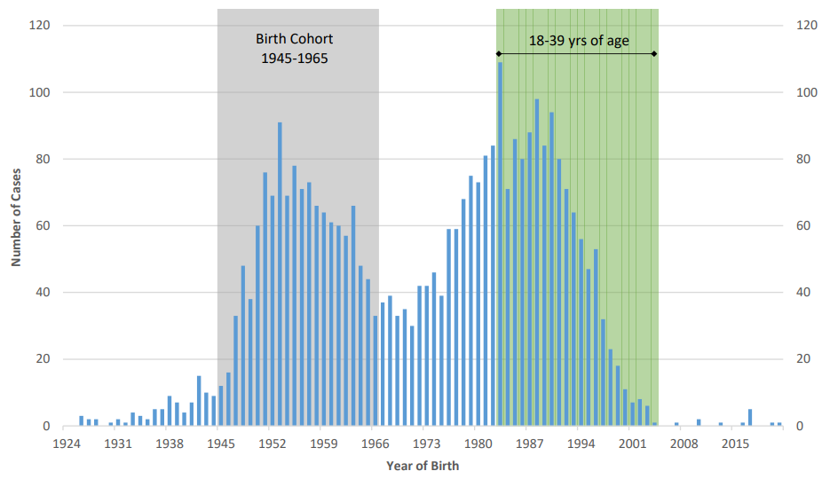
NUMBER OF CHRONIC HEPATITIS C CASES REPORTED TO MDHHS BY YEAR OF BIRTH, 2022
Source: Michigan Department of Health and Human Services. 2022 Hepatitis B and C Surveillance Report. Accessed February 2024.

Slide 19
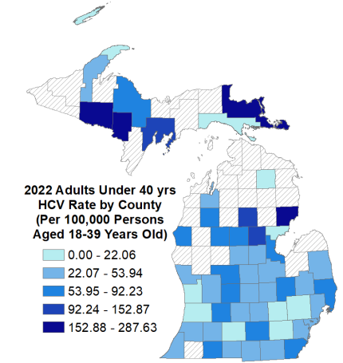
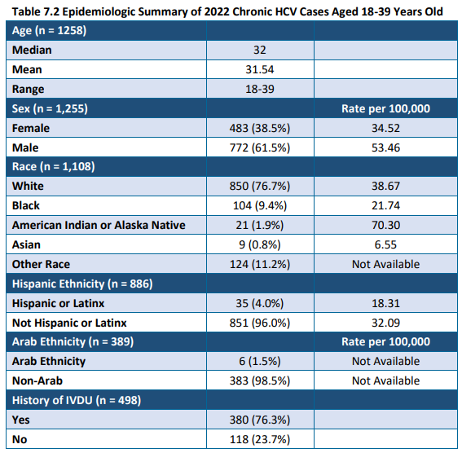
DEMOGRAPHICS & COUNTY RATE MAP 2022 CHRONIC HCV CASES AGED 18-39 YEARS OLD
Source: Michigan Department of Health and Human Services. 2022 Hepatitis B and C Surveillance Report. Accessed February 2024.

Slide 20
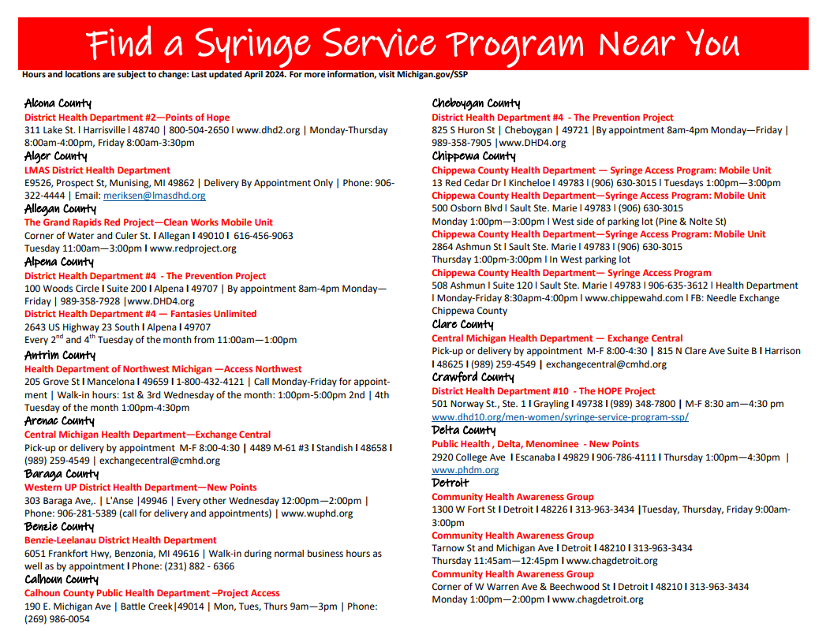
Michigan Syringe Service Programs (SSPs)
SSPs are community prevention programs that provide a range of services that prevent disease transmission. They are proven to save lives, reduce the harms of substance use, prevent overdose deaths, and reduce the impact of drug use on the community.
In Michigan:
  35 operating SSP organizations, 107 sites
  25 operating SSP organizations provide HCV testing and linkage to care
  Other services offered including but not limited to, linkage to substance use disorder treatment, access to and disposal of sterile syringes and injection equipment, vaccination, testing, linkage to care and treatment of infectious diseases, naloxone distribution
Syringe Service Program Directory and Map

Slide 21
HCV MORTALITY
30,000
Other Notifiable Infectious Conditions
25,000
20,000
Number of Deaths
15,000
HCV
10,000
5000
0
2003
2004
2005
2006
2007
2008
2009
2010
2011
2012
2013
Source: Centers for Disease Control and Prevention (2003 - 2013)

Slide 22
HCV MORTALITY – STATEWIDE (MI)
Hepatitis C death rates per 100K persons have increased since 2016.
Death counts are all confirmed chronic cases from MDSS that matched to an electronic death record in EDRS.
Population estimates 2016-2022 source: The United States Census Bureau
Notes:
We recently started looking into Michigan hepatitis C mortality rates by matching EDRS to our confirmed hepatitis C cases in MDSS (hep C had to be a cause of death on the death cert) and the rate of deaths attributable to chronic hep C has increased by 35% from 2016-2022

Slide 23
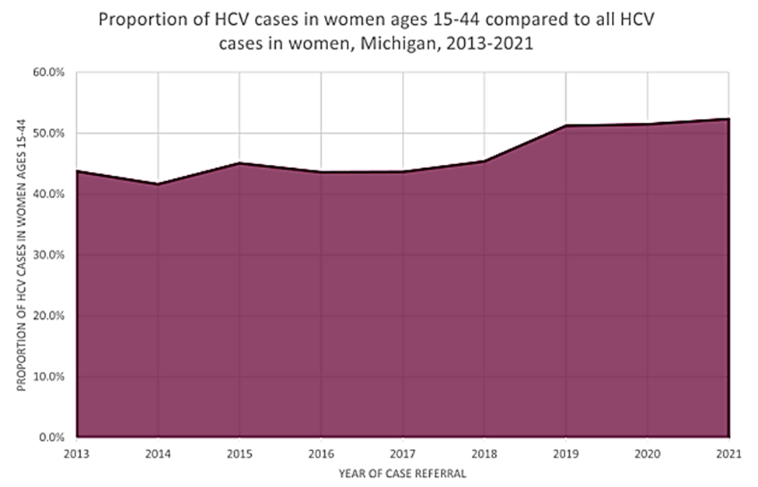
PROPORTION OF HCV CASES IN WOMEN AGES 15-44 COMPARED TO ALL HCV CASES IN WOMEN 2013-2021, Michigan Disease Surveillance System (MDSS)
Hepatitis C treatment should not be used among pregnant people and people who are breastfeeding
Hepatitis C treatment is approved for children 3 years and older
Source: Michigan Disease Surveillance System (2013-2021)

Slide 24
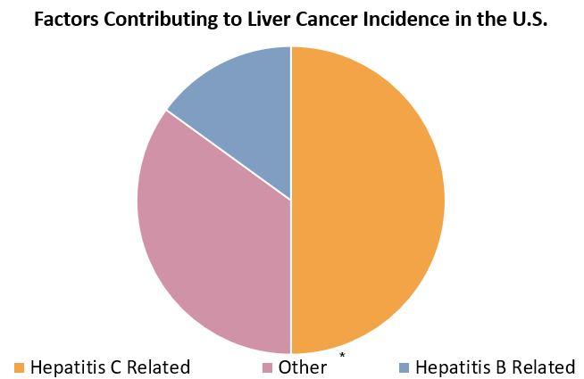
LIVER CANCER & VIRAL HEPATITIS
Hepatitis C
is curable.
*Other: Excessive alcohol use, obesity, diabetes, hemochromatosis, consumption of foods with aflatoxin
Source: Centers for Disease Control and Prevention (2016)

Slide 25
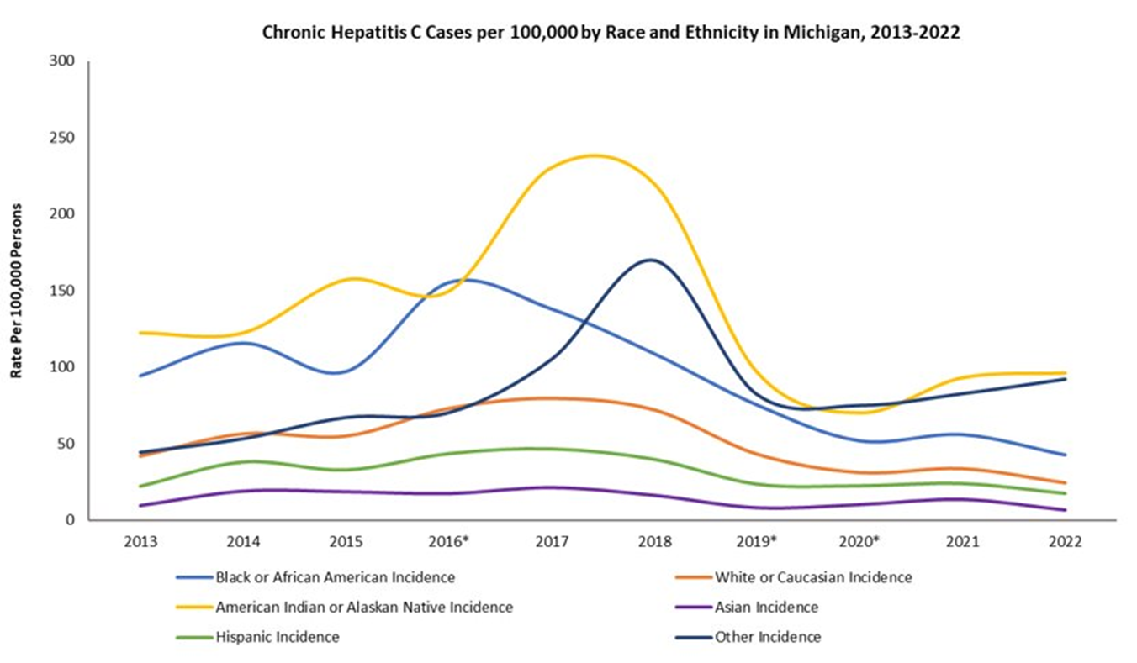
Racial Disparities with HCV
Race | Rate per 100k
American Indian or Alaska Native | 96.30
Other Race | 92.24
Black or African American | 42.56
White or Caucasian | 24.62
Hispanic | 17.41
Asian | 6.82
*Other races includes multiracial individuals and those reporting some other race alone.
Racial disparities in HCV occur in populations where we see racial disparities in overdose rates.
When we look at overdose deaths matched to HCV female cases by race and age, the highest proportion were among AI/AN under 40 years old at 58%, followed by White (36.7%), Black (4.6%), and Asian (<1%)

Slide 26
HCV TREATMENT - PREGNANCY
PREGNANCY:
  There is currently no HCV treatment approved for use during pregnancy
  HCV treatment is contraindicated during pregnancy due to lack of safety and efficacy data
CLINICAL TRIAL OF HCV TREATMENT IN PREGNANCY
First clinical trial researching treatment of hepatitis C among pregnant people using DAA Harvoni® (sofosbuvir/ledipasvir) during the second and third trimester.
  Enrolled 9 participants into study who completed study medication, delivered, and completed sustained virologic response (SVR) (indicative of cure) assessment
    All 9 participants (100%) who completed the SVR assessment achieved cure without any significant safety outcomes
    9 infants were enrolled and completed 1-year follow-up: none of the infants had a detectable HCV RNA test
Additional studies should evaluate safety and efficacy of pangenotypic regimens during pregnancy
Larger studies must be conducted to confirm safety and efficacy of hepatitis C treatment during pregnancy
To reach hepatitis C elimination, we need safe and effective interventions approved to treat hepatitis C in pregnant people

Slide 27
HCV TREATMENT - POSTPARTUM
POSTPARTUM:
HCV treatment can begin in the postpartum period after delivery
  However, if breastfeeding, treatment should be postponed during that time due to lack of studies regarding nursing while on HCV treatment
    HCV treatment may begin postpartum after completion of breastfeeding
  Individuals living with HCV can breastfeed their baby after delivery. There is no documented evidence that breastfeeding spreads hepatitis C, so persons living with HCV can safely breastfeed their babies
  Education around the use of nipple cream to prevent cracked nipples
  Is it safe for a mother living with HCV to breastfeed if nipples are cracked or bleeding?
      Data is insufficient to say yes or no; however, HCV is spread by infected blood
      If nipples and/or surrounding areola are cracked and bleeding, nursing should stop temporarily
      To maintain milk supply while not breastfeeding, breast milk should be expressed and discarded until nipples have healed
      Once nipples are no longer cracked or bleeding, breastfeeding may resume
      Referrals should be made to lactation support to learn how to maintain milk production and how to supplement with donor human milk or formula while temporarily not breastfeeding

Slide 28
BENEFITS OF TREATMENT AND CURE
Curative treatment reduces:
  Risk of liver cancer by 75%¹
  Risk of all cause mortality by 50%²
What does it mean to be cured?
  No longer have the virus active in their body
  No risk for transmitting the virus
  Will ALWAYS be HCV Ab positive/reactive
  Past liver damage may heal some
  Re-infection is possible!
1. Pan American Health Organization. (2018). PAHO calls for curative treatment for hepatitis to reduce thousands of preventable deaths in the Americas. https://www.paho.org/en/news/27-7-2018-paho-calls-curative-treatment-hepatitis-reduce-thousands-preventable-deaths-Americas.
2. Singal, AG, et al. Direct-Acting Antiviral Therapy for Hepatitis C Virus Infection is Associated with Increased Survival in Patients with a History of Hepatocellular Carcinoma. Gastroenterology. 2019; 157: 1253-1263.

Slide 29
HCV IS CURABLE!
PAST
PRESENT
Interferon-based
Low efficacy against the most common HCV genotype (treatment often was not curative)
Patients often experienced significant side effects
Direct-Acting Antivirals (DAAs) first received FDA approval in 2013
Curative (95%) for most patients and most genotypes
Improved patient quality of life: fewer side effects and shorter treatment duration (8-12 weeks)
Downside: previously very expensive
Since HCV is a fairly prevalent condition, this caused payers to strategize on how to curtail costs without an infinite budget

Slide 30
WE TREAT HEP C
INCREASING ACCESS TO HEP C TREATMENT TO PAVE THE WAY TO ELIMINATION

Slide 31
COMMON STRATEGIES TO CURTAILING COSTS
Prior Authorization: Before medications can be prescribed, a provider must submit paperwork to gain approval for writing the script
Fibrosis Restrictions: Limiting prescriptions to only those patients with severe liver damage (e.g., F3 or F4 fibrosis score)
Provider Restrictions: Prescription must be written by, or in consultation with, a specialist (e.g., gastroenterologist, hepatologist, or infectious disease specialist)
Sobriety Restrictions: Patient must be sober from drugs or alcohol for 6 months to be eligible for treatment

Slide 32
HISTORY OF MICHIGAN MEDICAID HCV TREATMENT COVERAGE
2013 – The first HCV DAA receives FDA approval
2015 – Medicaid covers HCV DAAs on a case-by-case basis
2016 – Initiated formal coverage of HCV DAAs in January of 2016
  F3/F4 Fibrosis
  Prescription must be written by, or in consultation with, a gastroenterologist, hepatologist, or infectious disease specialist
  Patient must demonstrate 6 months of sobriety
2017 – Fibrosis score lowered to F2
2018 – Fibrosis score lowered to F1
2019 – Fibrosis score lowered to F0, thereby removing fibrosis score requirement

Slide 33
SOLUTION TO EXISTING TREATMENT REQUIREMENTS
In 2019, after removal of fibrosis score restrictions, three treatment requirements still remained:
  Prior authorization
  Sobriety restrictions
  Provider restrictions
Solution:
  “Netflix-Like” Subscription Model
    State enters into an agreement with HCV treatment manufacturer to pay a set price for access to an unlimited supply of the company’s HCV medication over a period of several years
    Beneficial tool for increasing availability and cost-effectiveness of treatment
Michigan released a Request for Proposal (RFP) in August 2020
  HCV treatment manufacturers submitted proposals
  Proposals were reviewed and best bid selected

Slide 34
WE TREAT HEP C (WTHC) INITIATIVE
MDHHS launched the We Treat Hep C Initiative on April 1, 2021, as a strategy to increase access to HCV treatment and eliminate HCV in Michigan
Treatment with MAVYRET® is available to all Medicaid ($1 copay) and Healthy Michigan Plan (no copay) beneficiaries at little to no cost.
  Other DAAs ($3 copay) will require prior authorization and is approved when MAVYRET® is not clinically appropriate.
WHAT
HOW
WHO
We Treat Hep C Initiative aims to make treatment more accessible by removing barriers to prescribing
MDHHS has entered into
an agreement with AbbVie, the manufacturer of MAVYRET® (glecaprevir/pibrentasvir)
Treatment is available to
all Medicaid and
Healthy Michigan Plan beneficiaries

Slide 35
MAVYRET
Pangenotypic (works against every genotype)
For treatment-naïve persons and those with compensated cirrhosis
Three tablets, once daily for eight weeks
No limitation regarding renal function
Approved for adults and children 3+
Cure rates of 95-99%
Adverse reactions: <10% of subjects reported headache and fatigue

Slide 36
WE TREAT HEP C (WTHC) INITIATIVE
Mavyret no longer requires prior authorization (PA), effective April 1, 2021
  PA requirements for non-preferred DAAs still exist but have been streamlined (general PA form required for non-preferred DAAs)
Removal of all HCV DAA restrictions: documentation of recent/current substance use and specialist requirement have been removed
Any prescriber with prescriptive authority can cure HCV!
  However, many providers do not have experience treating HCV due to historical prior authorization requirements limiting treatment to specialists
  Program’s success is dependent on getting more providers to test and cure HCV!

Slide 37
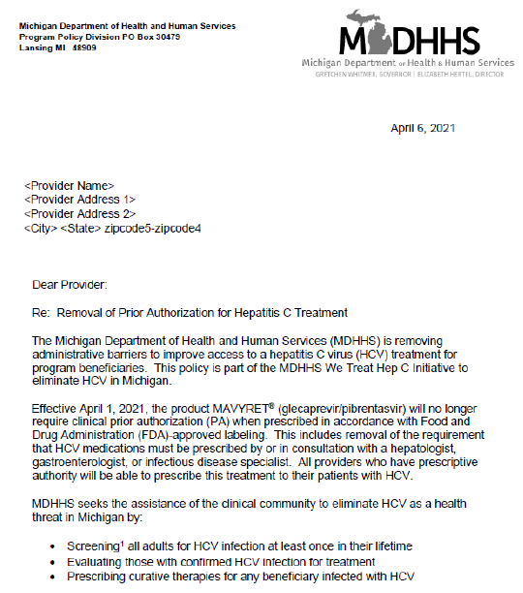

PROVIDER OUTREACH
Provider Letter L21-21
Tribal Health Directors
Academic Detailing
Professional Medical Societies, Associations, and various conferences
Licensing and Regulatory Affairs
Press releases, proclamations, social media
Medicaid Health Plans

Slide 38
HCV CLINICAL CONSULTATION RESOURCES
HENRY FORD HEALTH SYSTEM: Complimentary clinical consultation line and e-mail box for health care professionals with questions about HCV treatment. Operated from 8 A.M. – 5 P.M. M-F (313) 575-0332
WAYNE STATE UNIVERSITY/MIDWEST AIDS TRAINING AND EDUCATION CENTER (MATEC): Offers free hepatitis C clinical decision support and consultation monthly available to all health care professionals. Click here for the session schedule and registration information. For all other consultation, technical assistance, or training requests, call 313-962-2000, or e-mail MATECMichigan@wayne.edu.
OVERDOSE PREVENTION ENGAGEMENT NETWORK (OPEN): Provides hepatitis C provider consultations for substance use related cases and education, both online learning and live webinars.
MSU & MICHIGAN CENTER FOR RURAL HEALTH: Assist providers and members of the health care team throughout Northern Michigan and the Upper Peninsula to manage infectious disease patients more effectively and confidently. Free CME for healthcare professionals.
Additional trainings and resources available at Michigan.gov/WeTreatHepC
Join the We Treat Hep C listserv by e-mailing MDHHS-Hepatitis@Michigan.gov!

Slide 39
SINCE APRIL 2021 (LAUNCH OF WTHC)
Added 632 new HCV treatment prescribers
Screened 629,307 Medicaid beneficiaries for HCV
Treated 5,836 total Medicaid beneficiaries for HCV
Source: Claims data from the Michigan Medicaid program (2021- 2024)

Slide 40
MEDICAID BENEFICIARIES TESTED BY MONTH, 2018-2024, MI
Most recent data provisional due to lag in Medicaid claims data
We Treat Hep C Initiative
Kick-Off
April 2021
Michigan Stay Home,
Stay Safe Order
March-June 2020
Source: Claims data from the Michigan Medicaid program (2018-2024)

Slide 41
MEDICAID BENEFICIARIES STARTED HCV TREATMENT BY MONTH, 2018-2024, MI
Fibrosis Score
Lowered to F0
October 2019
We Treat Hep C Initiative
Kick-Off
April 2021
Fibrosis Score
Lowered to F1
October 2018
Most recent data provisional due to lag in Medicaid claims data
Michigan Stay Home,
Stay Safe Order
March-June 2020
Source: Claims data from the Michigan Medicaid program (2018-2024)

Slide 42
HCV TREATMENT PROVIDERS PRESCRIBING TREATMENT FOR MEDICAID BENEFICIARIES EACH QUARTER, 2018-2024, MI
Most recent data provisional due to lag in Medicaid claims data
We Treat Hep C Initiative
Kick-Off
April 2021
Source: Claims data from the Michigan Medicaid program (2018-2024)

Slide 43
CUMULATIVE TOTAL OF NEW PROVIDERS WHO PRESCRIBED HCV TREATMENT FOR MEDICAID BENEFICIARIES, 2018-2024, MI
We Treat Hep C Initiative
Kick-Off
April 2021
Source: Claims data from the Michigan Medicaid program (2018-2024)

Slide 44
MEDICAID BENEFICIARIES SCREENED FOR HCV DURING PREGNANCY FOR PREGNANCIES THAT ENDED 2018-2024, MI
Most recent data provisional. Have not yet received screening data for current pregnancies
CDC Releases Universal HCV Testing Recommendations
April 2020
Source: Claims data from the Michigan Medicaid program (2018-2024)

Slide 45
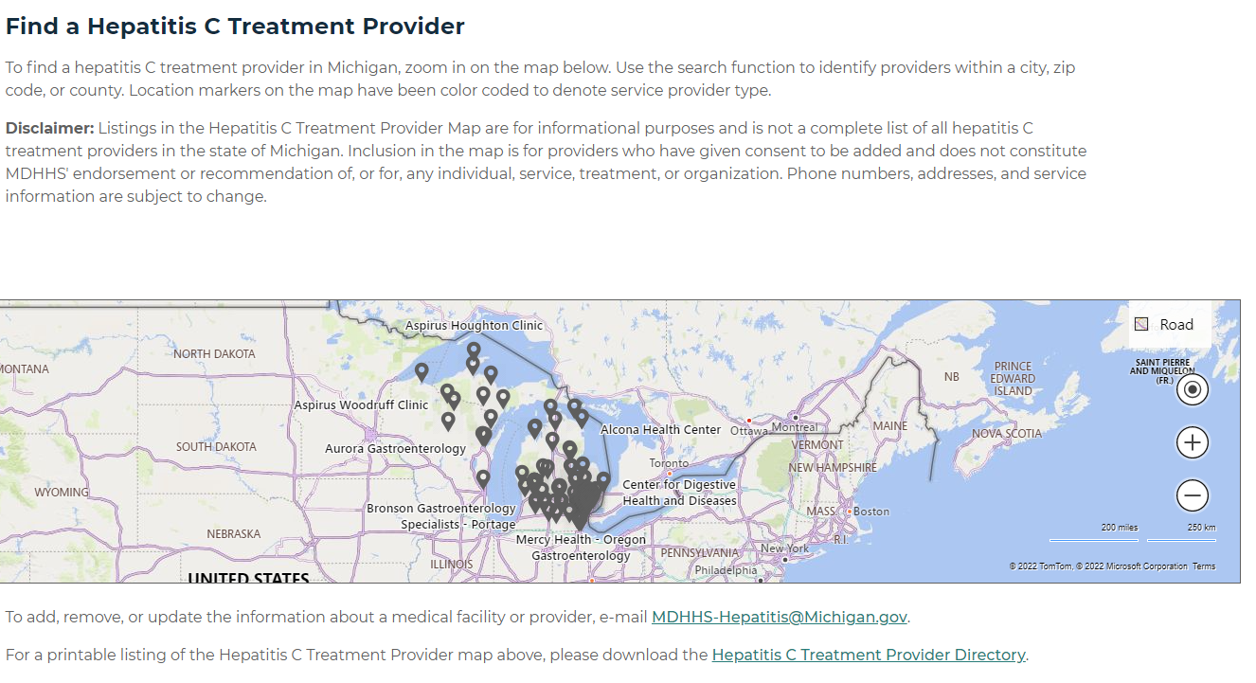
HEPATITIS C TREATMENT PROVIDER MAP
Michigan.gov/WeTreatHepC

Slide 46
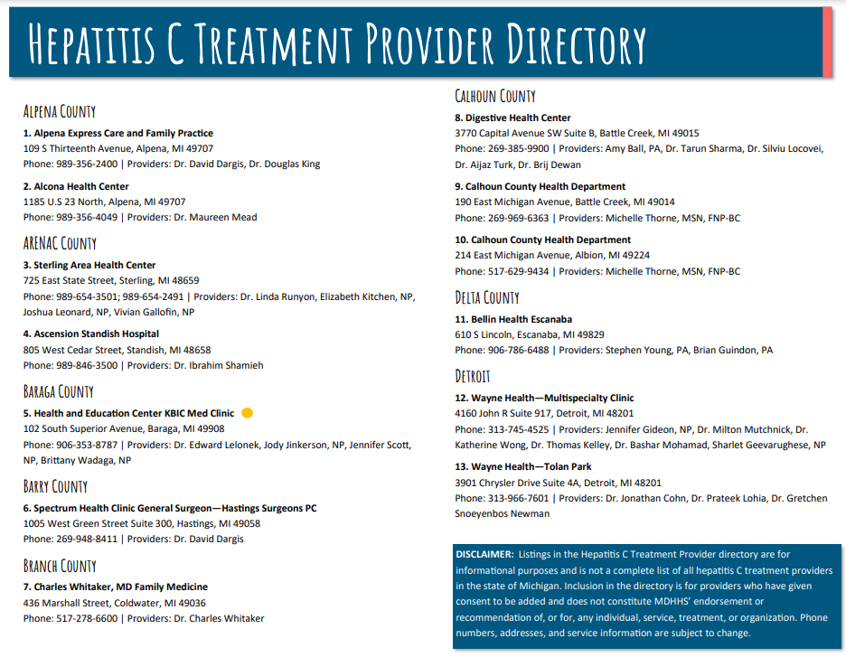
HEPATITIS C TREATMENT PROVIDER DIRECTORY

Slide 47
HEPATITIS C
LINKAGE TO CURE

Slide 48
HEPATITIS C DIS UNIT
8 Disease Intervention Specialists​
    7 Hepatitis C DIS​
    1 Hepatitis C - Tuberculosis DIS​
Unit was created October 1, 2021
Prioritization on case management services to achieve desirable outcomes such as treatment start and SVR-12
  SVR-12 = Sustained virologic response. Test of cure. It means that 12 weeks or more post treatment, lab test (ex: HCV RNA) does not detect hepatitis C virus in your blood (viral load is undetected).

Slide 49




HCV DIS GOALS
Diagnosis: Educate cases about HCV and current status
Link to care: Refer cases to healthcare/community resources
Treatment: Assist with treatment start and adherence
SVR-12: Ensure case achieves sustained virological response
Notes:
diagnosed with chronic HCV; (c) linked to HCV care; (d) liver disease assessed; (e) started on treatment in (year); (f) achieved sustained virological response (SVR) in (year); and (g) accessed chronic post-SVR care.
SVR12 – DIS assist with requesting lab order if needed, making sure lab received order, and reminding case to complete lab.

Slide 50
TYPES
OF CASES
Moms
Moms living with HCV
Babies born to HCV+ moms
11 Health department jurisdictions
Justice involved
Henry Ford emergency department
HCV/HIV coinfection
Women of childbearing age
Referrals from providers/cases
Notes:
Explain how we capture Mom cases – Identify Mom cases by a vital records match and our surveillance HCV cases.
Explain justice involved – following individuals who will be released from incarceration soon and has been identified as HCV+, may have started tx while incarcerated, and need f/u or need to be L2C.
GHOST – specimens tested and link cases with similar genomes. Assist w finding clusters and understand transmission patterns

Slide 51
BARRIERS TO DIS OUTREACH
Loss to follow-up (LTFU) is an issue and is a barrier to HCV elimination.
*When a case is linked to a DIS, it improves the odds of retaining the individual in each step through the HCV care cascade.
History of Houselessness
Mental Illness
Insurance Type
Younger Age
Injection Drug Use
Tested in Hospital
Incarceration Status
Notes:
Treatment in hospital: HCV clinic integrated into a primary care center increases linkage to care for patients with chronic HCV.
Insurance type: Used to be that those with Medicaid insurance were less likely to complete an evaluation and were less likely to be approved for treatment but with the WTHC initiative we are seeing that more so with those with private insurance.

Slide 52
BARRIERS TO CARE AND CURE
Rank | Barrier | Frequency
1 | Misconceptions on HCV treatment | 357
2 | Misconceptions around HCV | 333
3 | Confused on medical next steps | 181
4 | Feels healthy | 92
5 | Too busy to go to appointments | 80
6 | Transportation barrier | 63
7 | Living situation is unstable | 43
8 | Wants to see a different medical provider | 41
9 | Using drugs/alcohol | 37
10 | No medical home | 33
11 | Other priority health concerns | 33
12 | Limited or no income | 30
13 | Have to work during clinic hours | 25
14 | Uninsured | 23
16 | Forgot about HCV appointments | 20
17 | Pregnant or breastfeeding | 16
18 | Childcare is not available/affordable | 12
19 | Guardianship | 12
20 | Personal documentation barrier | 5
Providers not ordering the full course of treatment
  Pharmacies not having Mavyret or other DAAs in stock which pauses treatment = missed doses
HCV testing
  Providers only ordering Ab test
  For lab that do reflex test for medical staff to draw enough serum = insufficient/QNS
Long wait times for appointments
Telemedicine unavailable
Provider’s awareness and/or perceptions around WTHC
Source from MDHHS DIS Database, ACCESS, 2024
Notes:
Need to order from specialty pharmacy, schedule delivery and refill delivery if not dispensed all at once.
From GB - Be sure to cover the most common misconceptions on HCV treatment and HCV in general

Slide 53
Mom, Pregnant, Perinatal Barriers Identified
Mom and Pregnant Cases
Perinatal Cases
Rank | Barrier | Frequency
1 | Misconceptions on HCV treatment | 35
2 | Confused on medical next steps | 34
3 | Misconceptions around HCV | 32
4 | Too busy to go to appointments | 25
5 | Wants to see a different medical provider | 15
6 | Pregnant or breastfeeding | 14
7 | Feels healthy | 13
8 | Transportation barrier | 13
9 | Childcare is not available/affordable | 10
10 | Living situation is unstable | 9
11 | No medical home | 9
12 | Using drugs/alcohol | 7
13 | Forgot about HCV appointments | 7
14 | Have to work during clinic hours | 4
16 | Other priority health concerns | 3
17 | Limited or no income | 2
18 | Uninsured | 2
19 | Guardianship | 1
20 | Personal documentation barrier | 1
Rank | Barrier | Frequency
1 | Misconceptions around HCV | 8
2 | Confused on medical next steps | 6
3 | Misconceptions on HCV treatment | 5
4 | Guardianship | 5
5 | Feels healthy | 3
6 | Transportation barrier | 3
7 | Too busy to go to appointments | 2
8 | Living situation is unstable | 2
9 | Pregnant or breastfeeding | 1
10 | Using drugs/alcohol | 1
11 | Have to work during clinic hours | 1
12 | Limited or no income | 1
13 | Uninsured | 1
14 | Wants to see a different medical provider | 0
16 | Childcare is not available/affordable | 0
17 | No medical home | 0
18 | Forgot about HCV appointments | 0
19 | Other priority health concerns | 0
20 | Personal documentation barrier | 0
Source from MDHHS DIS Database, ACCESS, 2024
Notes:
#1 –3 - reiterates why HCV education is important
From GB - Be sure to cover the most common misconceptions on HCV treatment and HCV in general

Slide 54
PERINATAL BARRIERS TO TREATMENT
Disconnect between OBGYN, birthing hospital, and pediatrician
Inappropriate pediatric testing
Child may be with foster parents or adoptive parents
Inability to swallow pellet formulation/pills
Notes:
Inability to swallow pills
Providers recommending treatment at age 12, No liquid form of DAAs available, there is a pellet formulation now that can be sprinkled on non-acidic/liquid foods --> peanut butter, nutella, frosting – take quickly, if dissolve - tastes bitter, don’t bite pellets. Practice taking ahead of time (use sprinkles?)
Disconnect between OBGYN, birthing hospital, and pediatrician
OB doesn’t tell birthing hosp about HCV+ mom, birthing hosp doesn’t know about HCV,
Child may be with foster parents or adoptive parents
Insurance coverage during guardianship process
Peds cases might not be with birth parent, adoptive parents, foster parents
Guardianship can be a reason for foster/adoption cases taking so long to get treatment. Insurance cannot cover the child until the guardianship process is confirmed and finalized.

Slide 55
SUCCESSES
From October 1, 2021 – May 17, 2024
  Attempted to contact 4,874 cases
                Of those 342 were Mom/Perinatal
  Interviewed and educated 1,889 cases
    Linked to Care: 475 cases, 71 mom/baby
    HCV treatment starts: 242 cases, 40 mom/baby
    SVR-12: 199 cases, 22 mom/baby
Case management services and DIS outcomes
Increase number of providers treating Hepatitis C
Partnership with Connected Health in Okemos, Michigan
  Offers gynecology and addiction medicine services
  Complete telehealth services
  Time between first telehealth appointment and medication in hand is 13 days
Source from MDHHS DIS Database, ACCESS, 2024
Notes:
Provided providers with WTHC information/resources that they can treat rather than refer out

Slide 56
CASE REVIEW:
DIS ASSISTED WITH MOM L2C/TREATMENT and BABY TESTED/L2C
Case History: Mom was pregnant. Unaware HCV+ prior to testing. Tested due to pregnancy HCV testing protocol. Has OBGYN but needs PCP. Wants to breastfeed. Wants HCV treatment but unclear about next steps. Concerned could transmit HCV to baby.
Barriers: Unhoused, transportation, previous drug use including intravenous drug use (IVDU), previous incarceration, needs to be connected to PCP, works two jobs (one 3rd shift), and stigma/shame of diagnosis for herself and child.
Notes:
Works two jobs making it difficult to stay at shelter and to keep OBGYN apts. Uses Medicaid transportation

Slide 57
CASE REVIEW:
SUMMARY OF DIS SUPPORT
During initial interview (Aug 2022) DIS informed of HCV treatment after pregnancy and breastfeeding and assisted case with scheduling GI appointment, appointment reminders, and assisted with scheduling birth control appointment after pregnancy.
Baby born Sept 2022.
Contacted pediatrician to inform of HCV exposure and request HCV RNA order.
    Baby was inappropriately tested with HCV Ab, needed to go back for HCV RNA draw. RNA+ at 6 months old.
Bridged the gap between case and specialty pharmacy to receive Mavyret initial fill and refill.
Contacted ordering provider to request SVR12 order
Assisted with perinatal GI referral and appointment reminders
  Baby is monitored yearly, and liver functioning tests done every 6 mo-1yr. Will pursue treatment at 3yrs if needed. DIS continues case management with mom until child is eligible to start treatment.
  *Mom completed treatment and is cured. Baby continues yearly visits with pediatric gastroenterologist, last HCV viral load decreased from previous but still high. Mom has 4-year-old and unsure if was tested during that pregnancy, so will pursue testing for 4-year-old. Mom has stable housing, support, employment, attends methadone clinic/counseling, and is pursuing getting her driver’s license.
Notes:
Pediatrician unaware of HCV exposure – stigma in informing pedi, this is where DIS/support can step in to request HCV testing.
Case lost Medicaid due to income and is working to get health insurance, baby still has Medicaid/WIC

Slide 58
CASE TESTIMONIALS
“I’m sure I would have died from this (HCV) without your help, I appreciated all the help from the beginning with getting my medication and following up with my doctor appointments“
“Haven’t missed any doses. Forever grateful to you that I’m almost done and that I even got to get the script”
“You are awesome and glad you started calling me, I’d rather talk to you than my doctors, I trust you”
“It is such a good thing you are helping me because I would be so lost on what to do next. Thank you for checking-in and making sure no detail is forgotten. If it were up to me, I would have forgotten to take my meds and it’d be too late. Thanks again for the help for me and my family!”
“Thank you so much for all your help. You are changing my life in ways that I haven't been able to do on my own. I can't describe how much it means to me to have you advocating for me and my health. I appreciate you so much!”

Slide 59
Can MIHP Refer Clients To The HCV DIS Team?
YES!
If your client wants extra support to obtain HCV testing, linkage to care, and treatment please reach out to us
Client can self refer
Email or call us at MDHHS-DIS@Michigan.gov, 517-582-2224
Provide MDSS ID if applicable, along with your contact information and a brief description of client needs/barriers, and we will reach out to them. Please send email encrypted if contains personal identifiable/health information (PII/PHI) due to no MDSS ID

Slide 60
MAIN TAKEAWAYS
OPTIMIZE HCV TESTING
LINK TO CURE
EDUCATE
Education around CDC perinatal and universal HCV testing recommendations
Ensure pregnant persons receive complete testing (if HCV Ab is positive, that they also receive confirmatory HCV RNA testing to confirm active infection)
Ensure infants born to persons with current or probable HCV are tested appropriately
Link individuals with HCV to case managers and linkage to care coordinators to support individuals from testing to cure
Link infants/children who test positive for HCV with a provider with expertise in pediatric HCV
Address co-occurring barriers and increase accessibility (e.g., telehealth, collocated services, etc.)
Promote hepatitis C testing and treatment
Meet people living with hepatitis C where they are at and assist them with moving along the care continuum
Educate providers about testing and treatment recommendations and the We Treat Hep C Initiative

Slide 61
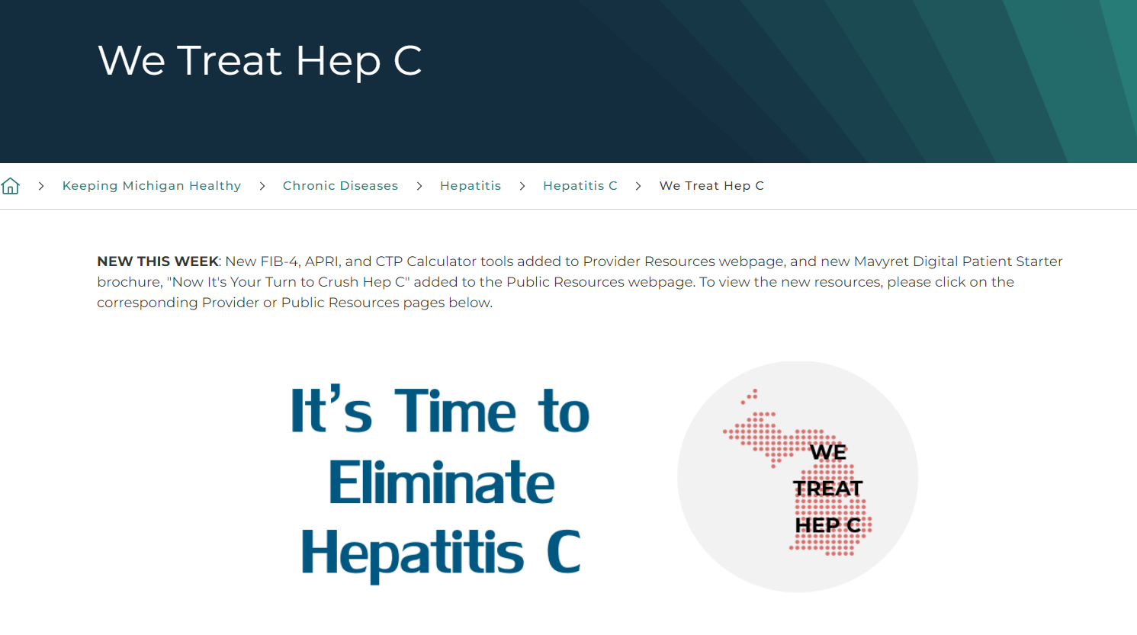
CHECK OUT OUR WEBSITES!
More HCV resources!
We Treat Hep C (michigan.gov)
MDHHS Perinatal HCV Toolkit
MDHHS Testing Recommendations for HCV Infants and Pregnant Persons
ACOG Clinical Practice Guideline – Viral Hepatitis in Pregnancy
AASLD/IDSA Guidelines for HCV Testing in Pregnancy
AASLD/IDSA Guidelines for HCV Testing and Treatment in Children
MDHHS Perinatal HIV, HBV, HCV, and Syphilis Testing and Reporting Guidelines
MDHHS Perinatal Infection Screening Flow Chart
Lab Resource Guide for HIV, Syphilis, HBV, and HCV Infection During Pregnancy
Perinatal HCV Fact Sheet
MDHHS Perinatal/STI Training Series – Course Website | Instructions for Accessing Training Series (2.5 total nursing contact hours)

Slide 62
THANK YOU!
Contact Information:
Teresa Juridico, MPH
Viral Hepatitis Prevention Coordinator
MDHHS
WongT@Michigan.gov
Nikki Wesorick, MPH
Disease Intervention Specialist
MDHHS
WesorickN@Michigan.gov
MDHHS Viral Hepatitis Unit
MDHHS-Hepatitis@Michigan.gov
MDHHS DIS Unit
MDHHS-DIS@Michigan.gov
Michigan.gov/WeTreatHepC
Michigan.gov/Hepatitis
Michigan.gov/SSP

