Slide 1


Slide 2



ABOUT MIRC
The Michigan Immigrant Rights Center (MIRC) is a statewide legal resource center for Michigan's low-income immigrant communities, working to build a thriving Michigan where immigrant communities experience equity and belonging.
LEGAL
SERVICES
SYSTEMIC
ADVOCACY
COMMUNITY ENGAGEMENT & EDUCATION
A program of Michigan Statewide Advocacy Services (MSAS) administered by Michigan Advocacy Program (MAP) .
2

Slide 3
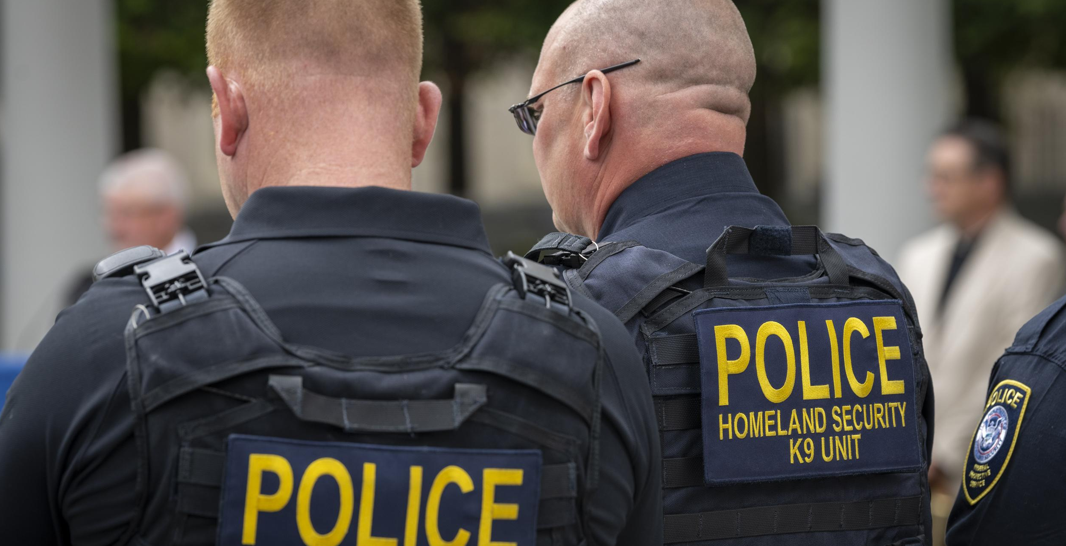
WHO IS CAPITAL “I” IMMIGRATION?
DEPARTMENT OF HOMELAND SECURITY (DHS)
DEPARTMENT OF JUSTICE EXECUTIVE OFFICE FOR IMMIGRATION REVIEW (EOIR)
Customs and Border Protection (CBP)
Immigration and Customs Enforcement (ICE)
United States Citizenship and Immigration Services (USCIS)
Immigration Courts (in Detroit, Michigan)
DEPARTMENT OF STATE (DoS)
Issues Visas
2 DHS Police Officers. Image
3

Slide 4
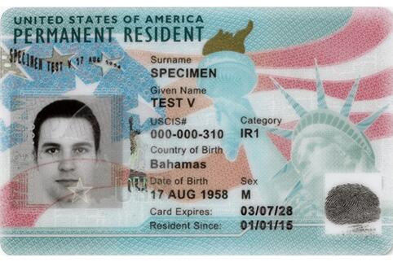
WHAT IS IMMIGRATION STATUS?
Citizen (USC) – through birth, naturalization, derivation, or acquisition
Permanent resident (LPR) – through family, business, lottery, or humanitarian bases
Non-immigrants (students, tourists, diplomats, etc.)
Temporary Protected Status (TPS)
Deferred Action, Parole
None (undocumented, overstays, etc.)
Lawful Permanent Resident Card (Green Card). Image
4

Slide 5
HOW CAN ONE IMMIGRATE?
BLOOD
SWEAT
TEARS
FAMILY-BASED
EMPLOYMENT
HUMANITARIAN
5

Slide 6
FAMILY-BASED BASICS
WHO CAN APPLY FOR WHOM?
No Waiting for Visa
Must Wait for Visa
U.S. citizens can apply for:
  Parents
  Spouses
  Minor children
NOTE: They are considered immediate relatives
U.S. citizens can also apply for:
  Siblings
  Adult children
Lawful Permanent Residents (green card holders) can apply for:
  Spouses, Minor children, Unmarried adult children
6

Slide 7
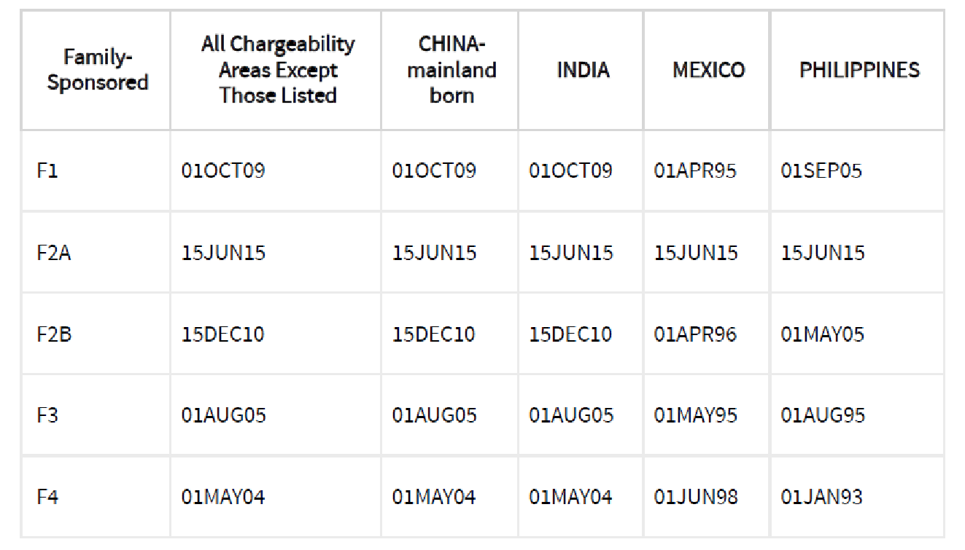
FAMILY-BASED BASICS
VISA BULLETIN
Example: Juan Antonio is a naturalized U.S. citizen who is originally from Mexico. He applied for his Mexican brother in 1999. When can his brother come to the U.S.?
https://travel.state.gov/content/travel/en/legal/visa-law0/visa-bulletin.html
7

Slide 8


FAMILY-BASED BASICS
UNLAWFUL PRESENCE
1 year-plus
Waiver available for the ten-year bar
  Beneficiary must demonstrate “extreme hardship” to their U.S. citizen, LPR spouse, or parents.
Subject to a permanent bar if entered illegally twice
INA 245(i): Allows people in this situation to pay a $1,000 penalty and adjust status in the U.S. without triggering the bar.
  Petition must have been filed on or before April 30, 2001.
BARRED 10 YEARS
8

Slide 9
EMPLOYMENT-BASED BASICS
Usually, the employer is the petitioner. The employer requests a specific worker and, for permanent resident visas, must establish that there is no U.S. worker available for the job. Categories are very limited and usually require high levels of education and skills.
Investor visas generally require a $500,000 investment that creates jobs. Often a franchise business is a path.
Small agricultural and seasonal guestworker programs exist
Student visas require the applicant to show cash resources to pay tuition, fees, and living expenses “up-front.”
No special tax breaks or incentives are given to immigrant residents who own businesses that are not given to U.S. citizens. In fact, some immigrants may face “double taxation” depending on the laws of their home country.
9

Slide 10
HUMANITARIAN-BASED BASICS
REFUGEES
ASYLEES
Identified outside of the U.S.
Defined as people who have a well-founded fear of persecution on account of their membership in a protected category.
Admitted in “refugee” legal status
Receive some social services and benefits after arrival.
Arrive in U.S.
Establish they meet the definition of a refugee to become asylees.
Often put in jail while they try to prove their case.
Required to prove:
  Unable or unwilling to return to home country because of a “well-founded fear” of persecution based on:
    Race
    Religion
    Membership in a social group
    Political opinion
    National origin
10

Slide 11
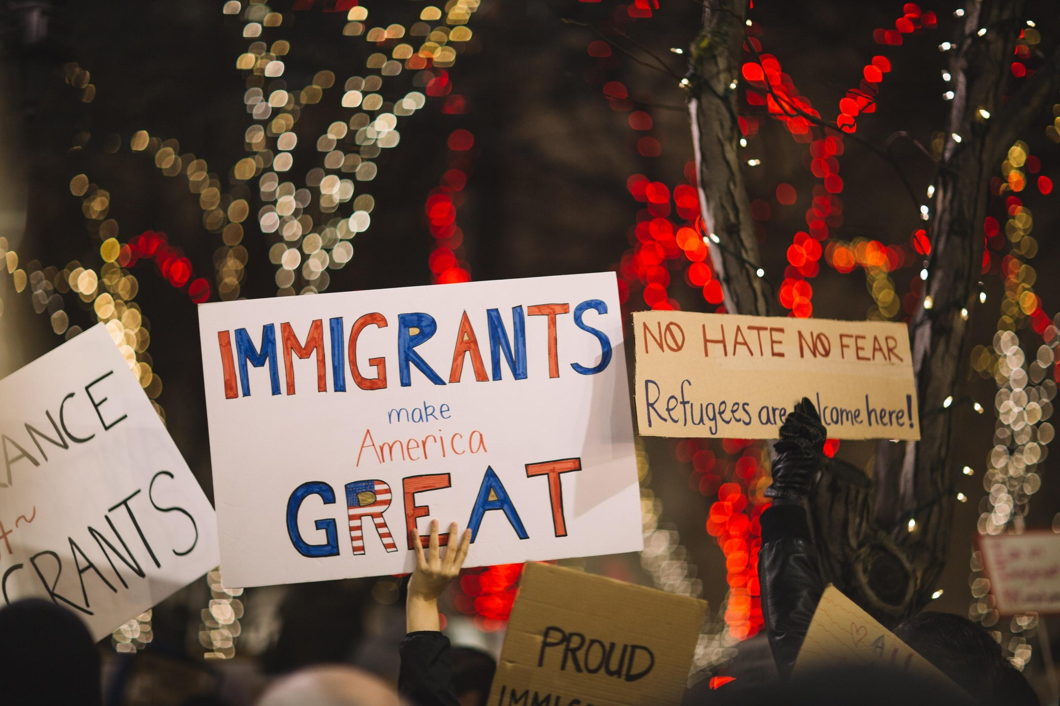
HUMANITARIAN-BASED BASICS
OTHER FORMS OF RELIEF
Violence Against Women Act (VAWA) - provides remedies for the battered spouses and children of USCs and LPRs
U visa - an option for victims of serious crimes who cooperate with law enforcement.
T visa – an option for victims of human trafficking
Special Immigrant Juvenile Status (SIJS) - may provide remedies for undocumented children in long-term foster care or who have been abused, abandoned, or neglected by one or both parents.
Temporary Protected Status (TPS) - for individuals from certain countries (such as Haiti, Syria)
Deferred Action for Childhood Arrivals (DACA)
Immigrants make America great sign. Image
11

Slide 12
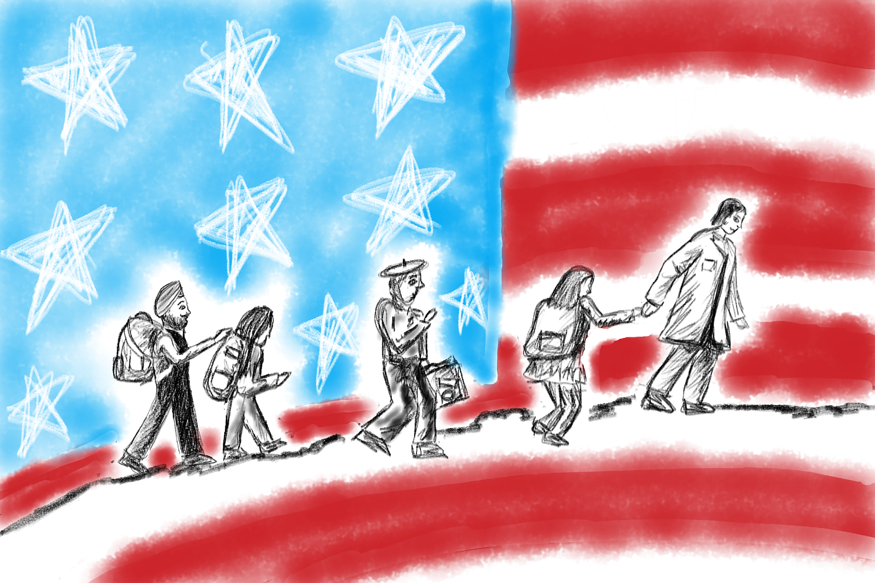
Some 2025 IMMIGRATION CHANGES
Enforcement
  All removable noncitizens are prioritized
  Workplace raids, court enforcement
  Removal of sensitive locations policy
  Expansion of detention
Regulations
  Ending certain TPS designations
  Expand definition federal public benefit
Discretionary
  Nationality bans
  Reduction in refugee resettlement
  Student visa decisions
  Birthright Citizenship: Still enjoined
Statutory
  Cut food assistance and Medicaid for refugees, asylees, and other previously protected groups
  Definition of “sanctuary”
Courts—agree to dismiss where enforcement / expedited removal is planned
People walking in front of an American flag (Image)

Slide 13
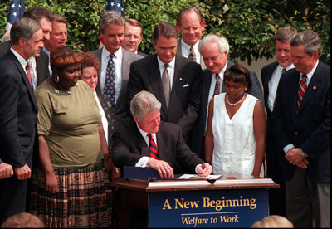
PUBLIC BENEFITS ELIGIBILITY
Most non-citizens are not eligible for federally-funded, means-tested programs
Unless permanent residents (LPRs) for 5 years
Limited exceptions:
  Refugees/Asylees no longer eligible for Medicaid and Food Assistance under new federal budget, not yet implemented
President Clinton Signing the Personal Responsibility and Work Opportunity Reconciliation Act of 1996 (PRWORA). Image
13

Slide 14

PUBLIC BENEFITS cont.
USC children in mixed-status households are eligible
Undocumented immigrants are only eligible for Emergency Services Only (ESO) Medicaid
Unemployment insurance compensation and workers compensation are not considered means-tested public benefits​
Recent update: Information about recipients and applicants has been accessible to DHS despite legal privacy protections
Mother and Daughter from Colombia. Image
14
Notes:
Residency question for students or other temporary residents:current BEM 220 https://mdhhs-pres-prod.michigan.gov/olmweb/ex/BP/Public/BEM/220.pdf A Michigan resident is an individual who is living in Michigan except for a temporary absence. Residency continues for an individual who is temporarily absent from Michigan or intends to return to Michigan when the purpose of the absence has been accomplished. Example: Individuals who spend the winter months in a warmer climate and return to their home in the spring. They remain MI residents during the winter months. Example: College students who attend school out of state but return home during semester breaks or for the summer can remain MI residents.Michigan State University (MSU) automatically enrolls international students in their Student Health Insurance Plan (SHIP).

Slide 15

SOCIAL SECURITY BENEFITS
Available to USCs, LPRs, refugees, asylees, Cuban/Haitian entrant, TPS (with enough quarters)​
Retirement: Generally, a person must have paid into the Social Security system in order to receive retirement benefits. Can start as early as 62 years old unless the payer dies so a child or widow could receive dependent or survivor benefits, respectively. ​
Disability: Again, generally, a person must have paid into the Social Security system in order to receive disability benefits, in addition to meeting the statutory definition of disabled.
Available to ​le to USCs; refugees, asylees, and Cuban/Haitian entrants only for seven years​
Supplemental Security Income (SSI):
These are disability benefits available to persons who never
paid (or only paid a little) into the Social Security System and
otherwise meet the statutory definition of disabled. Medicaid
is also approved for persons granted SSI benefits. ​
Notes:
[OPTIONAL SLIDE]

Slide 16

HEALTH INSURANCE
Who is eligible to purchase health insurance through the Marketplace?​
Formerly, virtually all statuses. After federal budget reconciliation, most statuses are excluded from eligibility starting in 2026. Going forward, only LPRs and Cuban-Haitian entrants. Has not yet been implemented.
Where can non-citizen seek health care if they are uninsured?​
Emergency rooms are required to provide care under the Emergency Medical Treatment and Labor Act (EMTALA).
This includes treatment for emergency medical conditions under ESOM, such as labor + delivery
For the options below, pending regulations purport to limit access to qualified immigrants
Community health centers,* migrant health centers,* and free clinics​
  To find a health center, go to findahealthcenter.hrsa.gov ​
  To find a free or charitable clinic, go to nafcclinics.org/find-clinic​
Public and safety-net hospitals​
Public health services (immunizations, mental health, screening and treatment for communicable diseases such as tuberculosis, HIV, sexually transmitted infections)​
Programs providing health services necessary to protect life or safety: emergency medical, food or shelter, mental health crisis, domestic violence, crime victim assistance, disaster relief​
Financial assistance or “charity care” programs at community health centers and most hospitals​
Notes:
[OPTIONAL SLIDE]

Slide 17
Immigration Enforcement and Child Welfare
Parents who are undocumented residents are not to be reported to the United States Department of Homeland Security (USDHS), as it is a violation of their due process rights for the supervising agency to deliberately take action with the purpose of virtually assuring the creation of a ground for termination of parental rights. Additionally, the supervising agency must not report children or identified relatives who are undocumented residents to USDHS. FOM 722-06K.
Notes:
Some changes since January: People who were previously not priorities for enforcement are now

Slide 18

CHIPRA Expansion
Removes 5-year bar for pregnant people and children to receive Medicaid if they are lawfully residing (for example):
  LPRs and both immigrant and non-immigrant visa holders
  Asylees and asylum seekers with work authorization
  Granted withholding of removal
  Deferred enforced departure and deferred action (not for childhood arrivals)
  Cuban and Haitian entrants
  Afghan SIV holders
  Those paroled into the U.S.
  TPS holders
  Special Immigrant Juveniles and applicants
  Victims of domestic violence and trafficking
Notes:
This was maintained after HR 1

Slide 19
UNACCOMPANIED CHILDREN
WHO ARE UCs?
WHERE ARE UCs FROM?
“Unaccompanied Alien Child” 6 USC 279(g)(2)
No lawful immigration status
Under 18 years old
No parent or guardian in the U.S., or no parent/guardian who is “available to provide care and physical custody”
UCs can come from any country
The vast majority of UCs come from the Northern Triangle in Central America: Guatemala, Honduras, El Salvador
Children from contiguous countries (e.g., Mexico) are subject to different procedures and more easily returned to their home countries
19

Slide 20

CROSSING THE BORDER
WHY ARE UACs COMING?
HOW DANGEROUS IS THE JOURNEY?
Family Reunification
Violence – domestic and gang-based
Economic/Educational Opportunities
Many are injured/maimed trying to hitch rides on trains across Mexico
Trek through the desert with little food/water
UACs are often targets of trafficking and violence, by fellow travelers, coyotes, and gangs
Desert. Image
20

Slide 21
MAPPING IT OUT
CHILD LEAVES
HOME COUNTRY
APPREHENSION AT BORDER
DHS DETENTION FACILITY
TRANSFER TO ORR CUSTODY
UAC STATUS DETERMINATION
PLACEMENT WITH SPONSOR
RELIEF
REMOVAL PROCEEDINGS
REMOVAL
21

Slide 22
Awareness of smuggling and harboring law
Federal law and the laws of some states criminalize several things someone might do or try to do to help another person come to or stay in the United States without authorization.
Usually, these laws have not been used against people who are not trying to profit from bringing in, transporting, or hiding undocumented people–but that the law does not require a profit motive and decisions about prosecutions might change.
Making sure that you are focused on your mission of access for all at all times and in the way you speak about your work is more important than ever.

Slide 23
COMMUNITY RESOURCES
Know Your Rights/Prepare Your Family
Nonprofit Immigration Legal Services
Michigan Legal Help Delegation of Parental Authority Online Tool (Available in English and Spanish)

Slide 24
CONTACT MIRC
IMMIGRATION
EMPLOYMENT
(non-citizens)
Naturalization
Relief for survivors of intimate partner violence, victims of crime
Unaccompanied children
Residents of Kalamazoo, Macomb, Oakland, Washtenaw, and Wayne counties
Deportation defense
Agriculture and farm work
Unpaid wages
Employer-provided housing
Employment discrimination
Sexual harassment
Labor trafficking
INTAKE
(Monday – Thursday)
INTAKE
(with Farmworker Legal Services)
(734) 239-6863
(800) 968-4046
CALLS FROM DETENTION: (734) 794-9963
Instructions for this free call are available in each ICE-contracted detention site (and our website)
24

