Slide 1
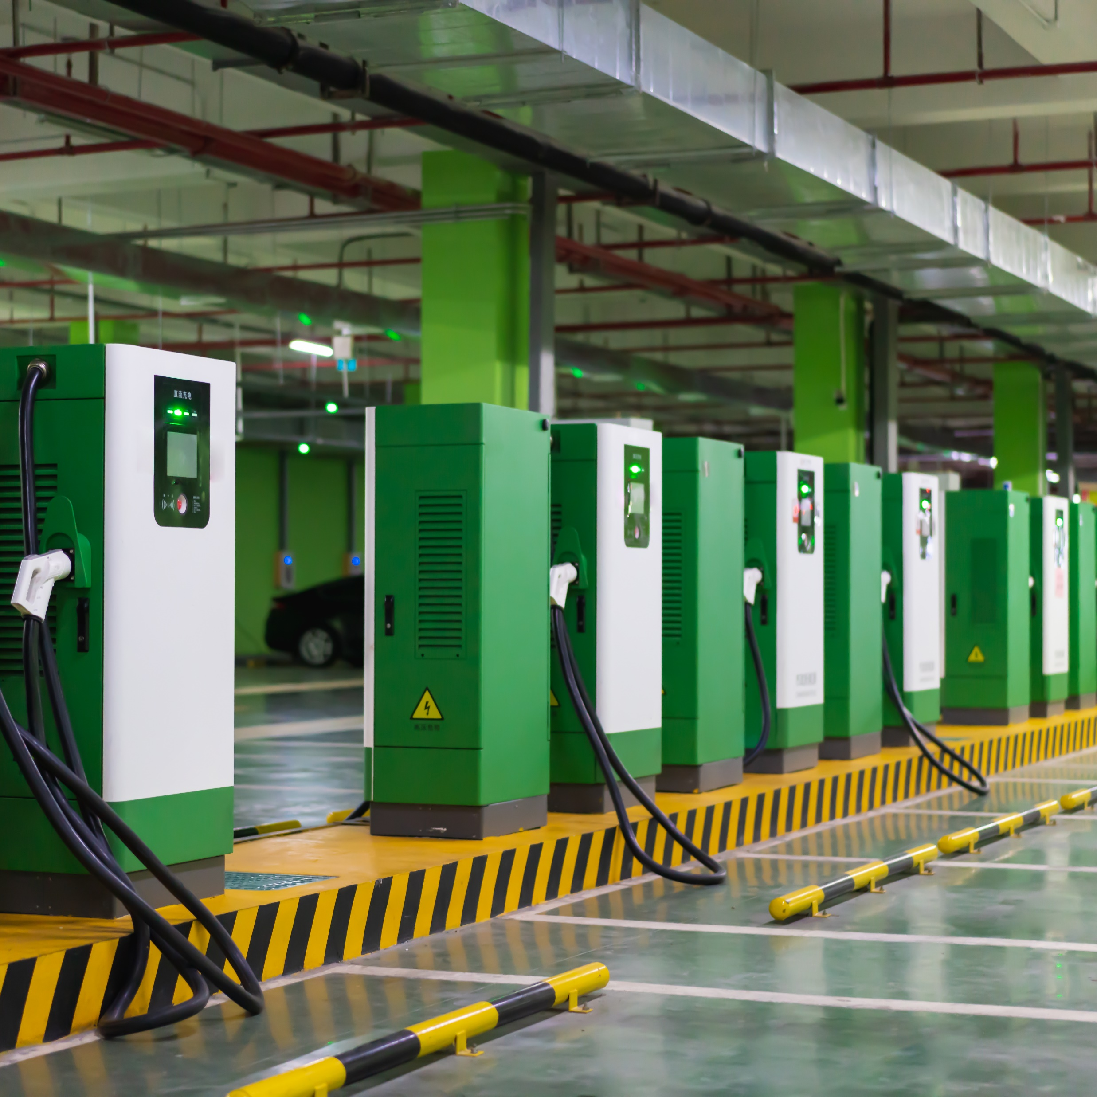



Charging and Fueling Infrastructure – Community Program
Application due:
6/13/2023
Available funding: $700M
Source: https://www.grants.gov/search-results-detail/346798
Document intended to provide insight based on currently available information for consideration and not specific advice

Slide 2

Community Grant provides funding to deploy publicly accessible electric vehicle charging and hydrogen, propane, and natural gas fueling infrastructure on publicly accessible locations
Goals and merit criteria for CFI - Community grants:
Program goals include
supplement, not supplant, necessary private sector investment;
complement existing Federal programs;
facilitate broad public access to a national charging and alternative fuel infrastructure network to accelerate adoption of zero emissions vehicles;
implement Justice40 objectives, lower transportation costs, and increase economic opportunity;
advance job quality, workforce development, and workforce equity; and
reduce greenhouse gas and vehicle-related emissions.
Source: https://www.grants.gov/search-results-detail/346798

Slide 3
CFI - Community Program Details
Project must be located on public roads or publicly accessible locations, including public parking facilities, public buildings, public schools, or public parks
Match funding requirement: 20%
Eligible grant uses
i) Install infrastructure to convert designated Corridor-Pending to Corridor-Ready AFCs, and for Corridor-Ready AFCs
i) development phase activities
Ii) acquisition and installation of eligible infrastructure, including any related construction or reconstruction and the acquisition of real property, to expand access to eligible infrastructure
Iii) educational and community engagement activities to develop and implement education programs through partnerships with schools, community organizations and vehicle dealerships
Requirements
i) Installation, operation, and maintenance by qualified technicians of EV infrastructure
Ii) Traffic control devices and on-premise signs acquired, installed, or operated
Iii) Network connectivity of EV charging infrastructure
iv) Interoperability of EV charging infrastructure
V) Data requested related to EV charging projects subject to this rule, including the content and frequency of submission of such data
Vi) Information on publicly available EV charging infrastructure locations, pricing, real-time availability, and accessibility though mapping application
Award amounts
Minimum and Maximum award
$0.5M - $15M (largest award in 2023 was $15M)
Previous awards (national)
2023 Awards
47 projects ($623M)
Previous awards (MI)
2023 Award
1 project ($8M)
Source: …
Source: FY23 CFI NOFO, FY23 CFI award fact sheet ; https://www.grants.gov/search-results-detail/346798

Slide 4
Eligible project description
Community Program eligible projects include:
Community Program grants may be awarded to any project that is expected to reduce greenhouse gas emissions and to expand or fill gaps in access to eligible infrastructure.
Eligible infrastructure is publicly accessible electric vehicle charging infrastructure, hydrogen fueling infrastructure, propane fueling infrastructure, or natural gas fueling infrastructure. Propane fueling infrastructure is limited to infrastructure for medium- and heavy-duty vehicles.
Projects may be located on any public road or in other publicly accessible locations, such as parking facilities at public buildings, public schools, and public parks, or in publicly accessible parking facilities owned or managed by a private entity
Corridor Program eligible projects:
Corridor Program grants must be awarded to any project that contracts with a private entity for acquisition and installation, or operation, of eligible infrastructure.
Eligible infrastructure is publicly accessible electric vehicle charging infrastructure, hydrogen fueling infrastructure, propane fueling infrastructure, or natural gas fueling infrastructure that is directly related to the charging or fueling of a vehicle. Propane fueling infrastructure is limited to infrastructure for medium- and heavy-duty vehicles.
Projects must be located along an alternative fuel corridor designated under this section, on the condition that any affected Indian tribes are consulted before the designation.
EV charging infrastructure should be conveniently and safely located as close to the AFC as possible, and, in general, no greater than one mile from Interstate exits or highway intersections along designated corridors.
Hydrogen fueling infrastructure, propane fueling infrastructure, and natural gas fueling infrastructure should be conveniently and safely located as close to the
Source: …
Source: https://www.grants.gov/search-results-detail/346798

Slide 5


High level requirements to apply for an CFI – Community grant
Projects that expand access to eligible infrastructure within rural areas, low- and moderate- income neighborhoods facilities will be prioritized
Eligible Entities
Key Application Components
  State or political subdivision of a State
  A metropolitan planning organization
  A unit of local government
  A special purpose district or public authority with a transportation function, including a port authority
  An Indian Tribe
  A territory of the United States
  An authority, agency, or instrumentality of, or an entity owned by, 1 or more entities as listed above
  A group of entities as listed above
  A State or local authority with ownership of publicly accessible transportation facilities
  Project description
  Statement of work
  Project location information identifying impacted location (a map in a PDF format)
  Project budget and funding information
  Narrative of how project meets selection criteria and DOT goals
Additional requirement on budget details
Budget details should include:
Planning and development
Property acquisition costs
Installation costs
Operation costs
Maintenance costs
Other preconstruction activity
Educational activity costs (if pursued)
Source: https://www.grants.gov/search-results-detail/346798

Slide 6

Examples of past winners in Michigan
Michigan Capitol Area Regional EV Charging Gateway Initiative (MI CAR–EVCGI) (2023)
Applicant: Clean Fuels Michigan
Impacted locality: City of Lansing
Funding: $8M
Project description: This investment will support the installation of up to 50 new public electric vehicle charging stations. The chargers will be placed to fill gaps in the existing network in Lansing and across mid-Michigan. The investment will significantly broaden access to EV charging infrastructure, ensuring a more inclusive and widespread adoption of electric vehicles. With increased charging options, EV drivers in Michigan can embark confidently on their journeys, knowing that reliable charging infrastructure is readily available
Source: FY23 CFI award fact sheet

