Slide 1
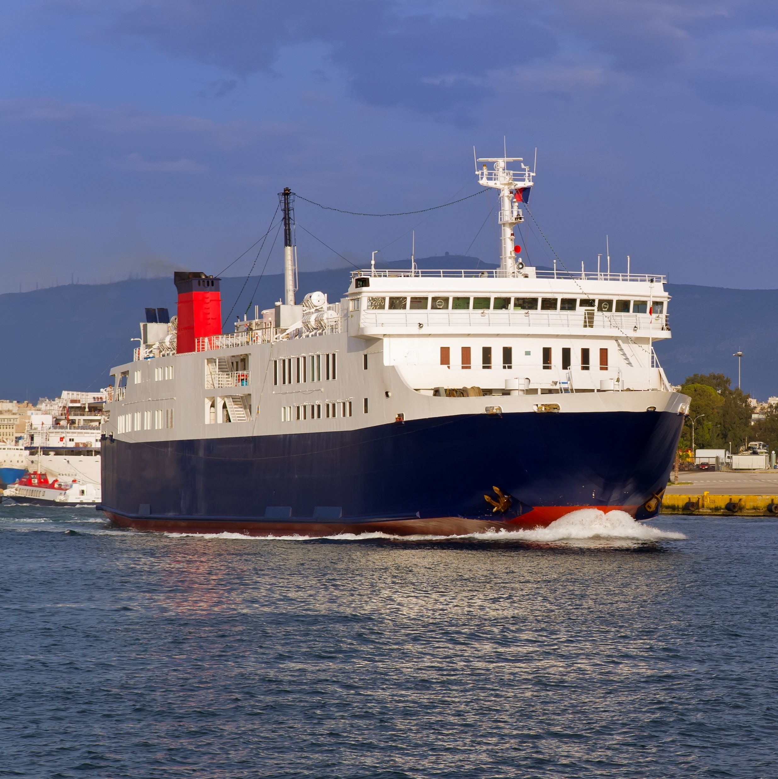



Passenger Ferry Grant
Program
Application due:
6/17/2024
Available funding for FY24: $51M
Source: FY24 NOFO
Document intended to provide insight based on currently available information for consideration and not specific advice

Slide 2

Passenger Ferry Grant provides funding for capital projects to purchase, replace, or rehabilitate passenger ferries, terminals, and related facilities and equipment
Goals and merit criteria for Passenger Ferry Grant:
FTA will consider the extent to which the projects address the following DOT Strategic Goals:
  renew transit systems
  reduce greenhouse gas emissions from public transportation
  advance racial equity
  maintain and create good-paying, jobs with a free and fair choice to join a union
  connect communities
Source: FY24 NOFO

Slide 3
Passenger Ferry Details
Match funding requirement: 20%
Passenger Ferry
Low-No Ferry
Description
Capital projects to purchase, replace, or rehabilitate passenger ferries, terminals etc.
low- or zero-emission ferries and related facilities/equipment
Eligible grant uses
Support existing ferry service, establish new ferry service, and repair and modernize ferry boasts, terminals, and related facilities and equipment¹
  Projects must support public transportation ferry systems serving an urbanized area
  Vehicle ferries are eligible if they also accommodate walk-on passengers.
  Workforce development/training (recipients are permitted to use up to 0.5% of the requested grant award for workforce development activities)
Award amounts
Minimum award
No minimum award
Maximum award
No maximum; largest award in 2023 was $72M
Award number
No specify, 13 projects have been awarded in FY23
Award type set aside
$5 million is set aside specifically for low- or zero-emission ferries and related facilities/equipment
Previous awards (national)
2022 Awards (25 applications)
8 projects ($34.4M total)
  7 projects ($97.6M total)
Previous awards (MI)
2022 awards
1 project ($6.7M)
1. Passenger Ferry Program may not be used to fund operating expenses, planning, or preventive maintenance
Source: …
Source: FY24 NOFO

Slide 4


High level requirements to apply for a Passenger Ferry grant
Eligible Entities
Key Application Components¹
  Providers of publicly owned public transportation service
  States and federally recognized Tribes that operate a public ferry system in an urbanized area
  The state or tribal territory should submit application on behalf of a local entity - and the local service provider should be the proponent of the project and included in the proposal development.
  Project description
  Statement of work
  Project location information identifying impacted location (a map in a PDF format)
  Project budget and funding information
  Narrative of how project meets selection criteria and DOT goals
  Transit Asset Management (TAM) Plan
    useful life benchmark for the vehicles
    state of good repair performance targets
Additional criteria FTA may consider
  Geographic diversity
  Diversity in transit system size
  Walk-on vs. vehicle boardings
  Address Climate Change and Sustainability
  Support the Creation of Good-Paying Jobs
  Support the Justice40 Initiative
1. Not the requirements to apply for TAC support. Not inclusive of all documents required to apply; please refer to NOFO for the full requirements and details
2. Excluding supporting documents
Source: FY24 NOFO

Slide 5


Examples of past winners in other states (MI has not won this grant in the past)
San Francisco Bay Area Passenger Ferry Project (2023)
Applicant: San Francisco Bay Area Water Emergency Transportation Agency
Impacted locality: City of San Francisco
Funding: $15.9M
Project description: The San Francisco Bay Area Water Emergency Transportation Agency will receive funding to retrofit two ferry floats with battery energy storage systems. The upgrades will improve service, reduce emissions, improve air quality and reduce electrical demand in downtown San Francisco and two terminals in the City of Alameda (Seaplane Lagoon and Main Street)
New York City Passenger Ferry Project (2022)
Applicant: New York City Department of Transportation
Impacted locality: New York City
Funding: $7.5M
Project description: The New York City Department of Transportation, on behalf of the Trust for Governors Island, will receive funding to build charging equipment to support future rapid charging for vessels serving Governors Island, which is solely accessible by ferry. A battery energy storage system will stabilize the demand on the island's power grid and support rapid charging of vessels and allow them to operate in zero-emissions mode, significantly reducing emissions, decreasing maintenance costs, and improving reliability
Source: FY24 NOFO

